Slide 1
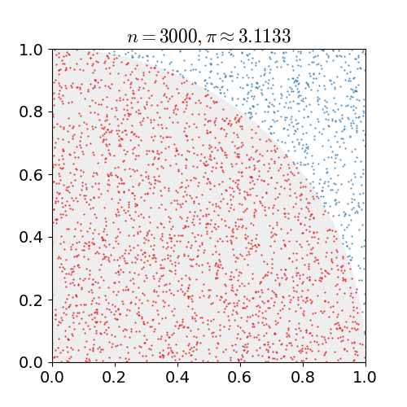

Monte Carlo Methods in Python
Monte Carlo Methods in Python
Many computer calculations employ Monte Carlo methods that include elements of chance to either:
Simulate random physical processes, such as thermal motion or radioactive decay, or
Estimate areas, volumes etc. by numerical integration
Monte Carlo Casino, Monaco, Cote-d-Azur, France

Slide 2

Monte Carlo Methods in Python
Polish-American Mathematician and Physicist
1909 (Lviv, modern-day Ukraine) – 1984 (Santa Fe, NM, USA)
Went to the US as refugee in 1939
Joined the Manhattan Project in Los Alamos while shrouded in secrecy
Taught at U. Wisc. Mad., U Colorado, U Florida, Rockefeller U, USC (LA), U Calif. (Davis) etc.
Came up with Monte Carlo while playing solitaire in hospital
Name coined due to an uncle who frequently gambled at the casino
Stanislaw Ulam
Monte Carlo Casino, Monaco, Cote-d-Azur, France

Slide 3
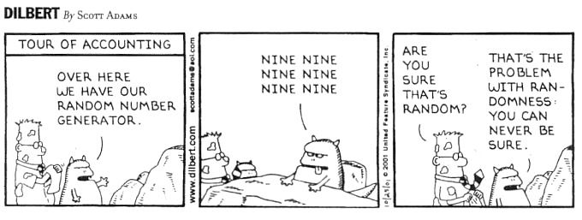
Monte Carlo Methods in Python
Monte Carlo Methods in Python
Randomness in deterministic computers???
Besides, how do even know if anything can be ‘random’??

Slide 4
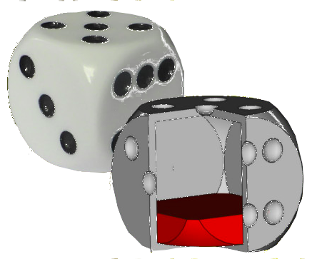
Monte Carlo Methods in Python
Monte Carlo Methods in Python
What is ‘randomness’, or a ‘random variable’?
Basically, it’s a special way of choosing the elements of a set. In our case, it involves choosing a single number from a particular subset of complex numbers , based on a probability of choice.
Uniform randomness: When all numbers in the subset are equally likely to be chosen
Non-uniform Randomness: When the probability of a particular choice depends on the value of the choice.
P(r) dr – Probability of a choice being in [r, r+dr]
Non- Uniform: P(r) depends on r
Uniform: P(r) constant

Slide 5
Monte Carlo Methods in Python
Monte Carlo Methods in Python
What is ‘randomness’, or a ‘random variable’?
Basically, it’s a special way of choosing the elements of a set. In our case, it involves choosing a single number from a particular subset of complex numbers, based on a probability of choice.
Mathematically, “independent randomness” occurs when there are no correlations between any two sets of choices from the same subset

Slide 6
Monte Carlo Methods in Python
Monte Carlo Methods in Python
What is ‘randomness’, or a ‘random variable’?
Basically, it’s a special way of choosing the elements of a set. In our case, it involves choosing a single number from a particular subset of complex numbers, based on a probability of choice.
Mathematically, “independent randomness” occurs when there are no correlations between any two sets of choices from the same subset
Obeys the ‘Central Limit Theorem’
Consider an arbitrarily large (infinite) array of independent random variables, called ‘A’.
By the law of large numbers, their average is a fixed constant and stdev
For a finite (but reasonably large) array of independent random variables from A , the probability that their sample average (times ) is a value ‘x’ (times ) is

Slide 7
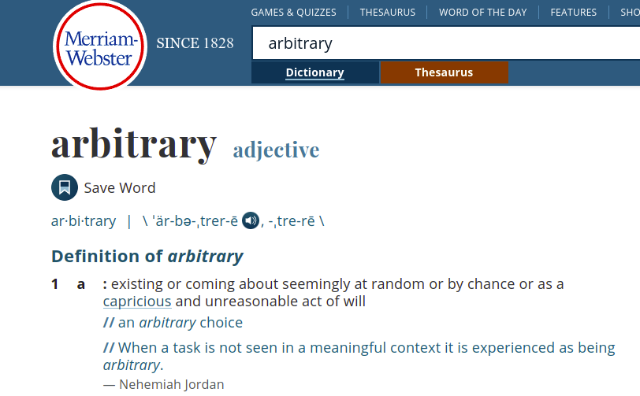
Monte Carlo Methods in Python
Monte Carlo Methods in Python
What is ‘randomness’, or a ‘random variable’?
Basically, it’s a special way of choosing the elements of a set. In our case, it involves choosing a single number from a particular subset of complex numbers, based on a probability of choice.
Note: In science, ‘Random’ and ‘Arbitrary’ are two different things!
Although they are used interchangeably in common parlance
Arbitrary choices have no well-defined probability, whereas random choices do

Slide 8


Monte Carlo Methods in Python
Monte Carlo Methods in Python
What is ‘randomness’, or a ‘random variable’?
Basically, it’s a special way of choosing the elements of a set. In our case, it involves choosing a single number from a particular subset of complex numbers, based on a probability of choice.
Note: In science, ‘Random’ and ‘Arbitrary’ are two different things!
Although they are used interchangeably in common parlance
Arbitrary choices have no well-defined probability, whereas random choices do
However, in some cases, depending on context, we have ignored this distinction
In Python: “Prove” that a Hermitian matrix always has real eigenvalues:
    Build a fairly large random numpy matrix , do the operation
    Get the eigenvalues numerically (usually a matrix tridiagonalization, followed by QR factorizations)
    Check to see if they’re all real up to the propagated numerical errors

Slide 9
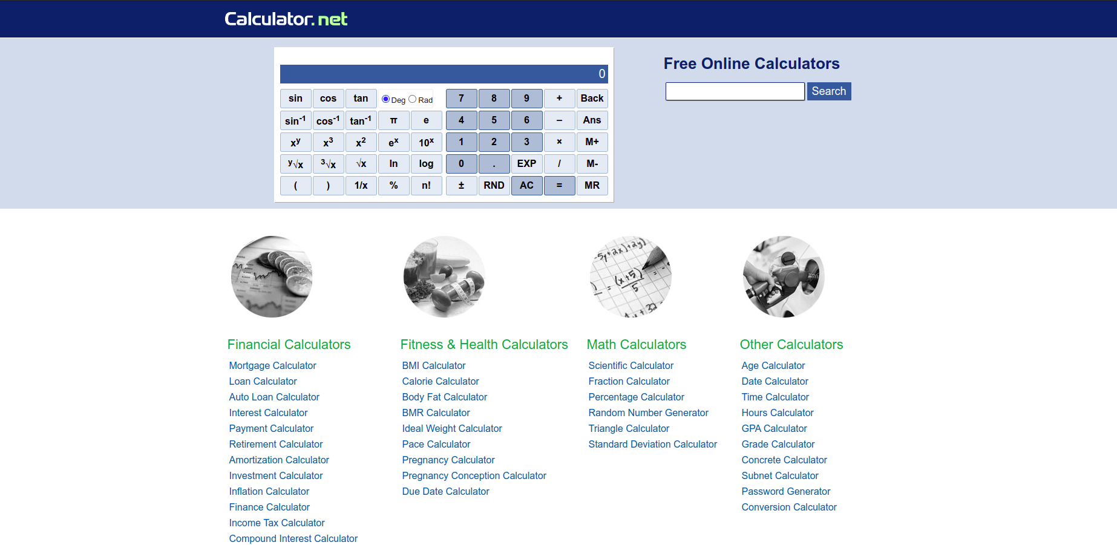
Monte Carlo Methods in Python
Monte Carlo Methods in Python
What is ‘randomness’, or a ‘random variable’?
Basically, it’s a special way of choosing the elements of a set. In our case, it involves choosing a single number from a particular subset of complex numbers, based on a probability of choice.
Standard Classical Computer CPU’s cannot generate random numbers
However, they can generate ‘nearly’ random, or pseudorandom numbers, usually by either
Chaotic maps
Exploiting ‘random’ floating point errors in remainders of divisions

Slide 10
Monte Carlo Methods in Python
Monte Carlo Methods in Python
Random numbers in NumPy: Uniform beteween 0 and 1 by default
Python 3.8.8 (default, Apr 13 2021, 19:58:26)
[GCC 7.3.0] :: Anaconda, Inc. on linux
Type "help", "copyright", "credits" or "license" for more information.
>>> import numpy as np
>>> print(np.random.random())
0.6226775696151192
>>> print(np.random.random())
0.7922634259220305
>>> print(np.random.random())
0.14630228848931848
>>> a = np.random.random((3,2)); print(a)
[[0.69190953 0.36821051]
[0.36047735 0.17258306]
[0.00406954 0.26549197]]

Slide 11
Monte Carlo Methods in Python
Monte Carlo Methods in Python
Random numbers in NumPy: Uniform beteween 0 and 1 by default
How to make the probability of a number r be biased by P(r)?
import numpy as np
def weighted_choice(objects, weights):
""" returns randomly an element from the sequence of 'objects',
the likelihood of the objects is weighted according
to the sequence of 'weights', i.e. percentages."""
weights = np.array(weights, dtype=np.float64)
# Normalize the weights:
weights /= weights.sum()
# “Integrate” the probabilities to find the cumulative probability
weights = weights.cumsum()
r = np.random.random()
for i in range(len(weights)):
if r < weights[i]:
return objects[i]
Cumulative “Weights”
Objects to choose from
Choose r uniform-randomly
If , then
return

Slide 12
Monte Carlo Methods in Python
Monte Carlo Methods in Python
Random numbers in NumPy: Uniform beteween 0 and 1 by default
How to make the probability of a number r be biased by P(r)?
import numpy as np
def weighted_choice(objects, weights):
""" returns randomly an element from the sequence of 'objects',
the likelihood of the objects is weighted according
to the sequence of 'weights', i.e. percentages."""
weights = np.array(weights, dtype=np.float64)
# Normalize the weights:
weights /= weights.sum()
# “Integrate” the probabilities to find the cumulative probability
weights = weights.cumsum()
r = np.random.random()
for i in range(len(weights)):
if r < weights[i]:
return objects[i]
Note that:

Slide 13

Monte Carlo Methods in Python
Monte Carlo Methods in Python
Random numbers in NumPy: Uniform beteween 0 and 1 by default
How to make the probability of a number r be biased by P(r)?
Example problems: See Jupyter Notebook
Radioactive Decay (exact)
Random Walks
Metropolis Algorithm and the Ising Model (1d and 2d)

Slide 14
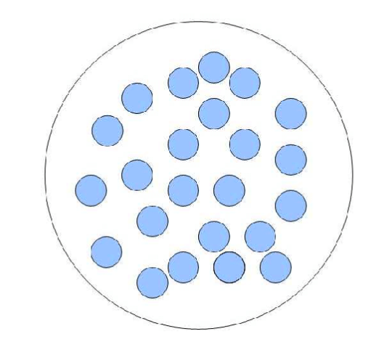
Monte Carlo Methods in Python
Monte Carlo Methods in Python
Example problems: See Jupyter Notebook
Radioactive Decay:
A sample of N radioactive atoms undergoing spontaneous decay
The probability P of decay within a given time interval is
proportional to the interval
Continuum Approximation

Slide 15
Monte Carlo Methods in Python
Monte Carlo Methods in Python
Example problems: See Jupyter Notebook
Radioactive Decay:
A sample of N radioactive atoms undergoing spontaneous decay
The probability P of decay within a given time interval is proportional
to the interval
Exact Simulation: At each time, for each atom, choose a random number ‘r’ and decrement N only if

Slide 16
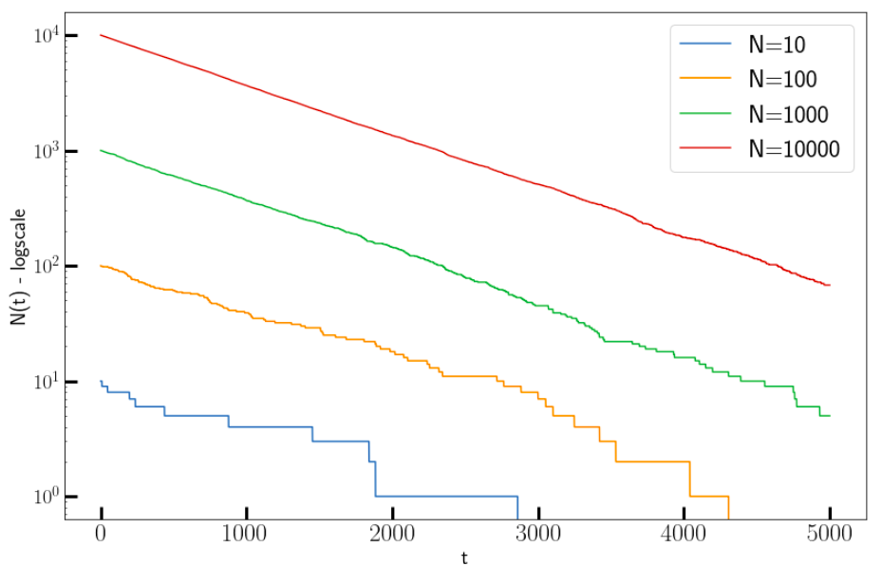
Monte Carlo Methods in Python
Adaptable to solving other ODE’s
import numpy as np
import matplotlib.pyplot as plt
plt.rcParams['figure.figsize'] = (12,8)
plt.rcParams['font.size'] = 20
# Decay constant
lambda1 = 1e-3
natoms_arr = [10, 100, 1000, 10000]
maxtime = 5000
timeline = np.arange(0, maxtime + 1)
for natoms in natoms_arr:
natoms_begin = natoms
natoms_time = []
for time in timeline:
decays = np.random.random(natoms)
natoms -= np.count_nonzero(decays < lambda1)
natoms_time.append(natoms)
plt.plot(timeline, natoms_time,label=f'N={natoms_begin}')
plt.ylabel("N(t) - logscale")
plt.xlabel("t")
plt.yscale("log")
plt.legend()
plt.show()

Slide 17
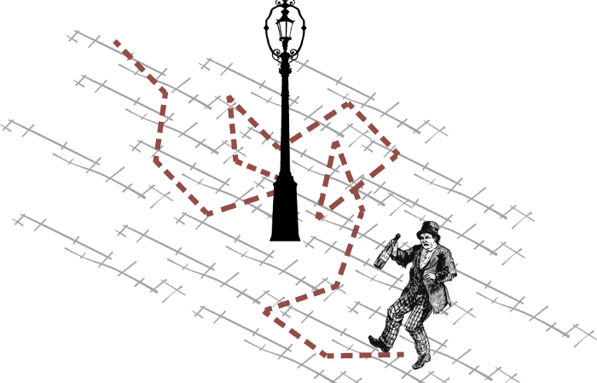
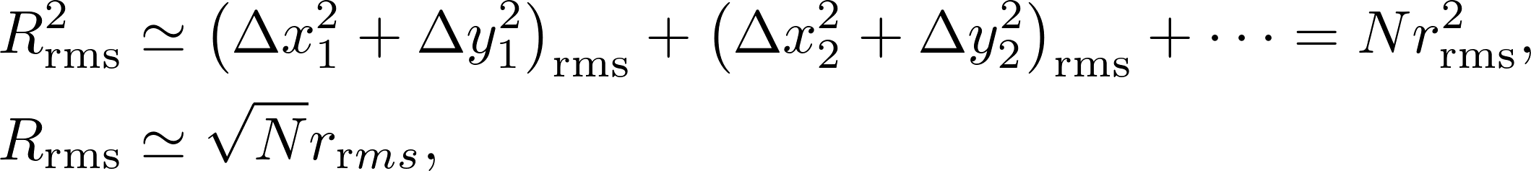
Monte Carlo Methods in Python
Monte Carlo Methods in Python
Example problems: See Jupyter Notebook
Random Walk Problem:
Monte Carlo-like model of Diffusion, Brownian motion etc.
A digital simulation of a ‘drunk man’, where a point advances along a graph in discrete steps
Each step can be of a random stepsize in a random direction, or fixed stepsize in a random direction.
Average over a large number of trials:

Slide 18
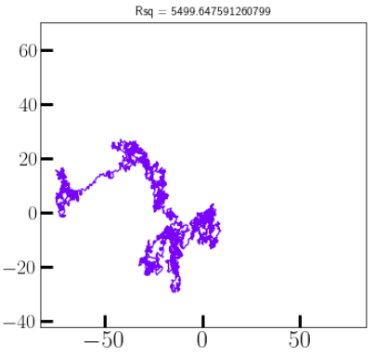
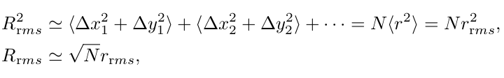
Monte Carlo Methods in Python
Monte Carlo Methods in Python
Example problems: See Jupyter Notebook
Random Walk Problem: Given the mean free path of air at room temperature (68 nm), how many collisions will it take for a single molecule suspended in air to travel 20 metres?
Molecule = Random Walker
Average over a large number of trials:

Slide 19
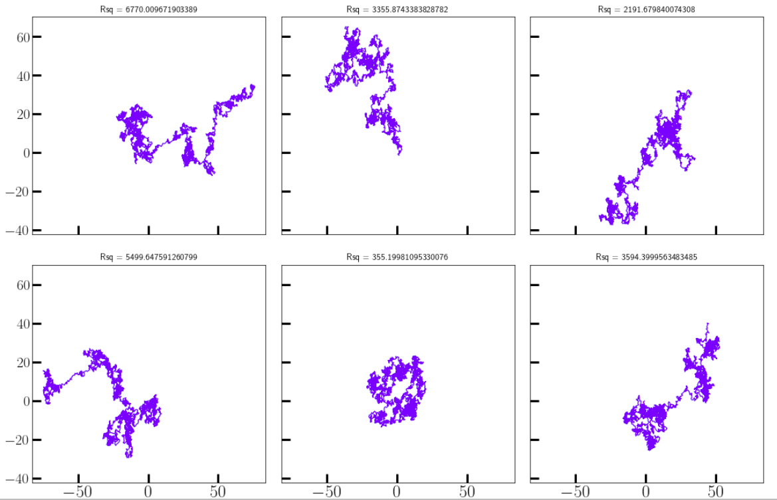
Monte Carlo Methods in Python
Monte Carlo Methods in Python
Example problems: See Jupyter Notebook
Random Walk Problem: Given the mean free path of air at room temperature (68 nm), how many collisions will it take for a single molecule suspended in air to travel 20 metres?
import numpy as np
import matplotlib.pyplot as plt
plt.rcParams['figure.figsize'] = (15,10)
plt.rcParams['font.size'] = 20
fig, axs = plt.subplots(2,3, sharex=True, sharey=True)
axs = axs.flatten()
jmax = 2500
for ax in axs:
dr_vals = 2.0 * np.random.random((jmax,2)) -1
Lvals = np.sum(dr_vals**2, axis=1)
dr_vals /= np.sqrt(Lvals[:, None])
points = np.cumsum(dr_vals, axis=0)
Rsq = np.linalg.norm(points[-1])**2
ax.set_title(f"Rsq = {Rsq}", fontsize=12)
ax.plot(points[:,0], points[:,1], color='blue', alpha=0.6)
plt.show()

Slide 20
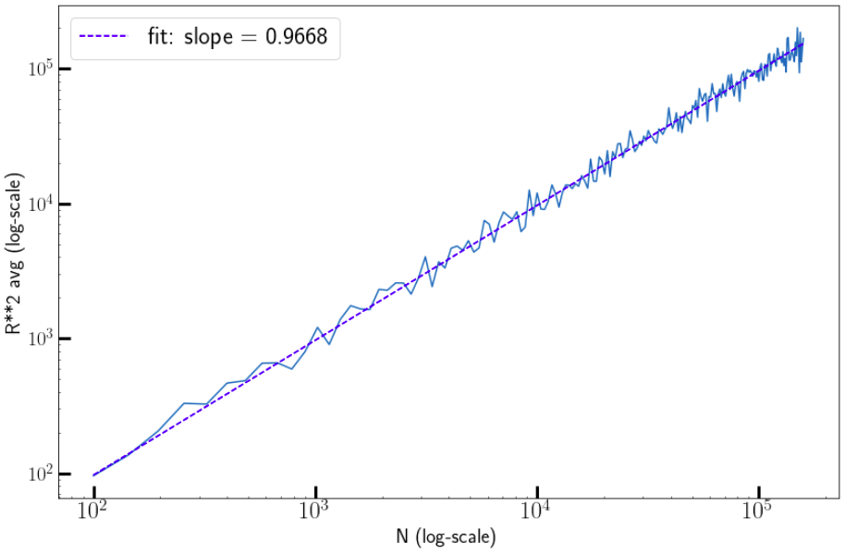
Monte Carlo Methods in Python
Monte Carlo Methods in Python
Example problems: See Jupyter Notebook
Random Walk Problem: Given the mean free path of air at room temperature (68 nm), how many collisions will it take for a single molecule suspended in air to travel 20 metres?
import matplotlib.pyplot as plt
from scipy.optimize import curve_fit
import numpy as np
plt.rcParams['figure.figsize'] = (12,8)
plt.rcParams['font.size'] = 20
def randwalk2d(nsteps, repeat=6):
points = []
for i in range(repeat):
dr_vals = 2.0 * np.random.random((nsteps,2)) -1
Lvals = np.sum(dr_vals**2, axis=1)
dr_vals /= np.sqrt(Lvals[:, None])
points.append(np.cumsum(dr_vals, axis=0))
return points
nsteps = np.arange(10,400,2)**2
Rsq_avs = []
for nstp in nsteps:
walks = randwalk2d(nstp, repeat=50)
Rsq_avs.append(np.average([np.linalg.norm(w[-1])**2 for w in walks]))
plt.loglog(nsteps, Rsq_avs)
popt, pcov = curve_fit(lambda x,a: a * x, nsteps, Rsq_avs)
plt.loglog(nsteps, popt[0] * nsteps, 'b--', label=f'fit: slope = {popt[0]:2.4f}')
plt.xlabel("N (log-scale)")
plt.ylabel("R**2 avg (log-scale)")
plt.legend(); plt.show()

Slide 21
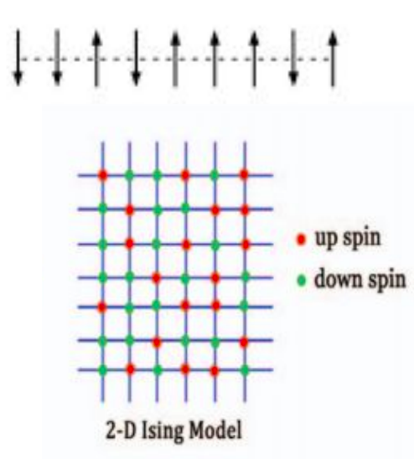
Monte Carlo Methods in Python
Monte Carlo Methods in Python
          Demo: Ising Model and the Metropolis Algorithm
Cannot get the exact partition function numerically
Too many combinations of spins for a large size

Slide 22
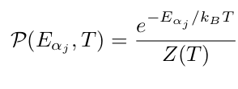
Monte Carlo Methods in Python
Monte Carlo Methods in Python
          Demo: Ising Model and the Metropolis Algorithm
The Metropolis Algorithm is a technique for computing the Monte Carlo calculation
of averages that accurately simulates the fluctuations occurring during thermal equi-
librium.
It changes individual spins randomly, but weights the changes such that on the average
a Boltzmann distribution results (Canonical Ensemble)

Slide 23
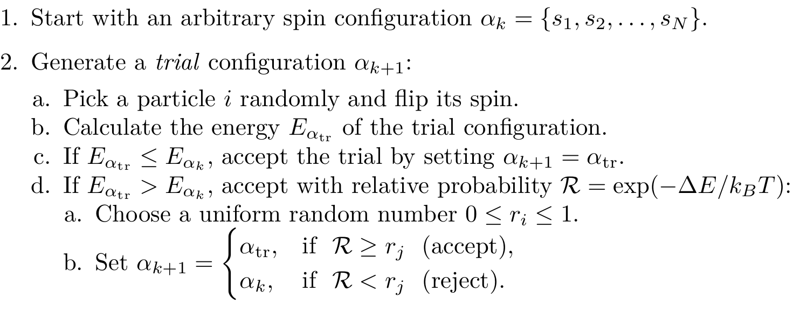
Monte Carlo Methods in Python
Monte Carlo Methods in Python
          Demo: Ising Model and the Metropolis Algorithm

Slide 24
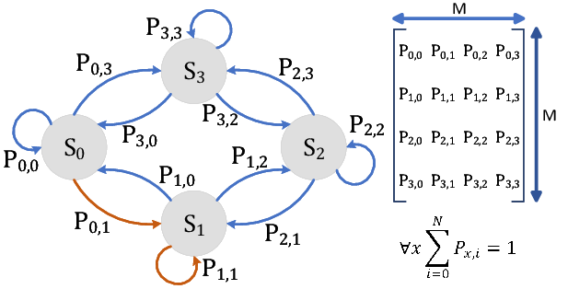
Monte Carlo Methods in Python
Monte Carlo Methods in Python
          Demo: Ising Model and the Metropolis Algorithm
Will this equilibriate into a Canonical Ensemble?
Markov Chain:
Each AB transition depends only on
Detailed Balance:
Happens when all transition probs balance out

Slide 25
Monte Carlo Methods in Python
Monte Carlo Methods in Python
          Demo: Ising Model and the Metropolis Algorithm
Will this equilibriate into a Canonical Ensemble?
Detailed Balance:
Happens when all transition probs balance out

Slide 26
Monte Carlo Methods in Python
Monte Carlo Methods in Python
          Demo: Ising Model and the Metropolis Algorithm
Will this equilibriate into a Canonical Ensemble?
Detailed Balance:
Happens when all transition probs balance out

Slide 27
Monte Carlo Methods in Python
Monte Carlo Methods in Python
          Demo: Ising Model and the Metropolis Algorithm
Will this equilibriate into a Canonical Ensemble?
Detailed Balance:
Happens when all transition probs balance out

Slide 28
Monte Carlo Methods in Python
Monte Carlo Methods in Python
          Demo: Ising Model and the Metropolis Algorithm
Videos: 2D without field

Slide 29
Monte Carlo Methods in Python
Monte Carlo Methods in Python
          Demo: Ising Model and the Metropolis Algorithm
Videos: 2D without field

Slide 30
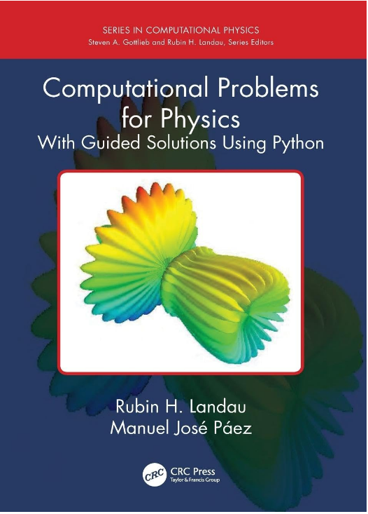
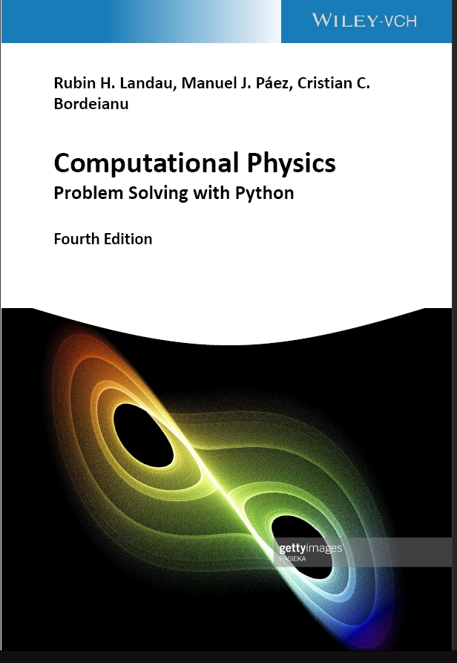

References
ISBN: 978-1138705418
https://tinyurl.com/landau-paez-bordeianu

